Slide 1
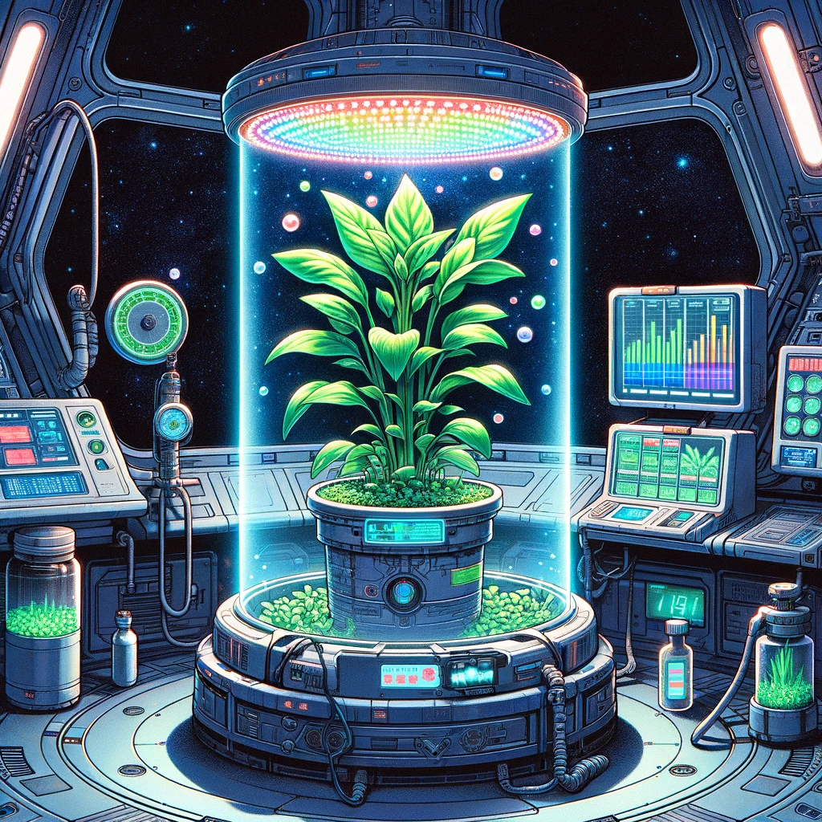
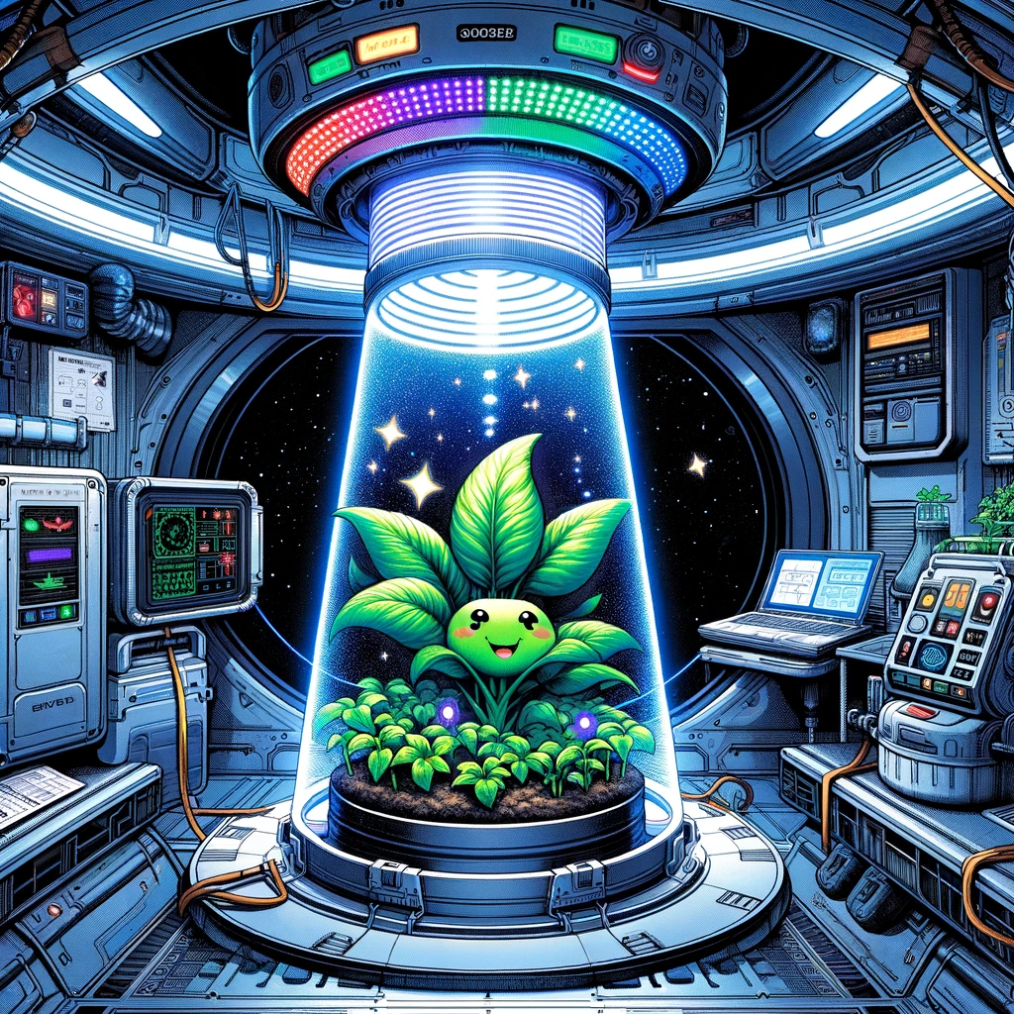
Lighting can be customized to improve plant health
Photosynthesis in Space uses CO2 and produces O2 just like on Earth
Notes:
A vibrant green plant aboard a spaceship is basking in the glow of a specialized LED growth light.
Photosynthesis in SpaceThe light spectrum is optimized for space conditions, and small oxygen bubbles can be seen emerging from the plant's leaves. Dialogue: Plant: "Ah, nothing beats a good dose of tailored light to kickstart my day!""

Slide 2
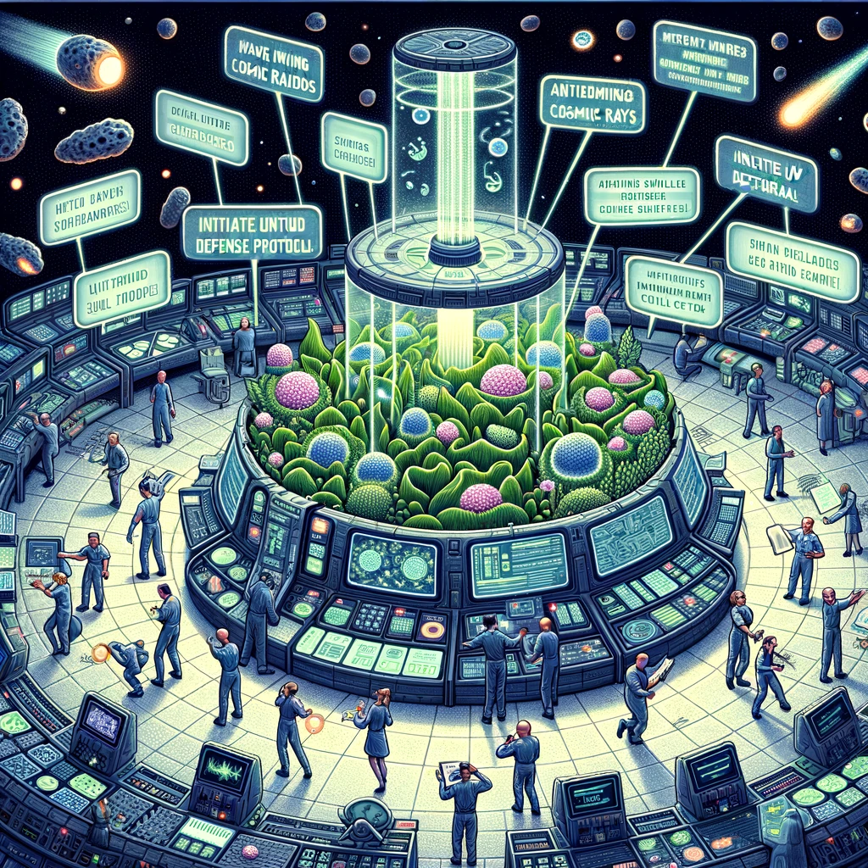
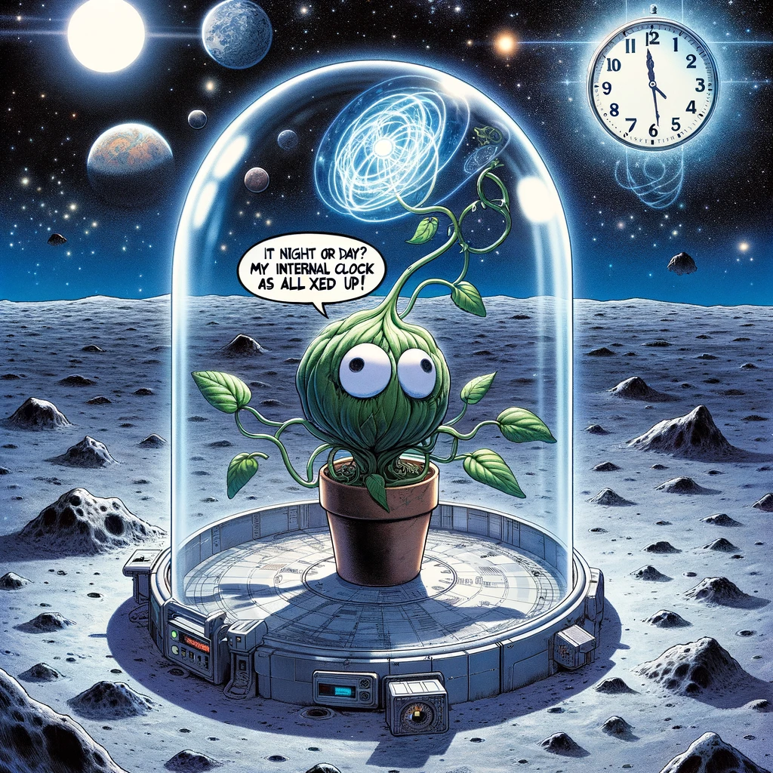
Not having a circadian rhythm can confuse biology
But life in space can be stressful as there are many factors
Notes:
Panel 2: Plant Development under Different Conditions
Description: Two plants side by side, one in a habitat simulating Mars and the other Earth. The Mars plant is shorter with thicker leaves, while the Earth plant is taller and more spread out.
Dialogue: Mars Plant: "Low gravity makes me feel light!" Earth Plant: "But I miss the breeze and the bees!"

Slide 3
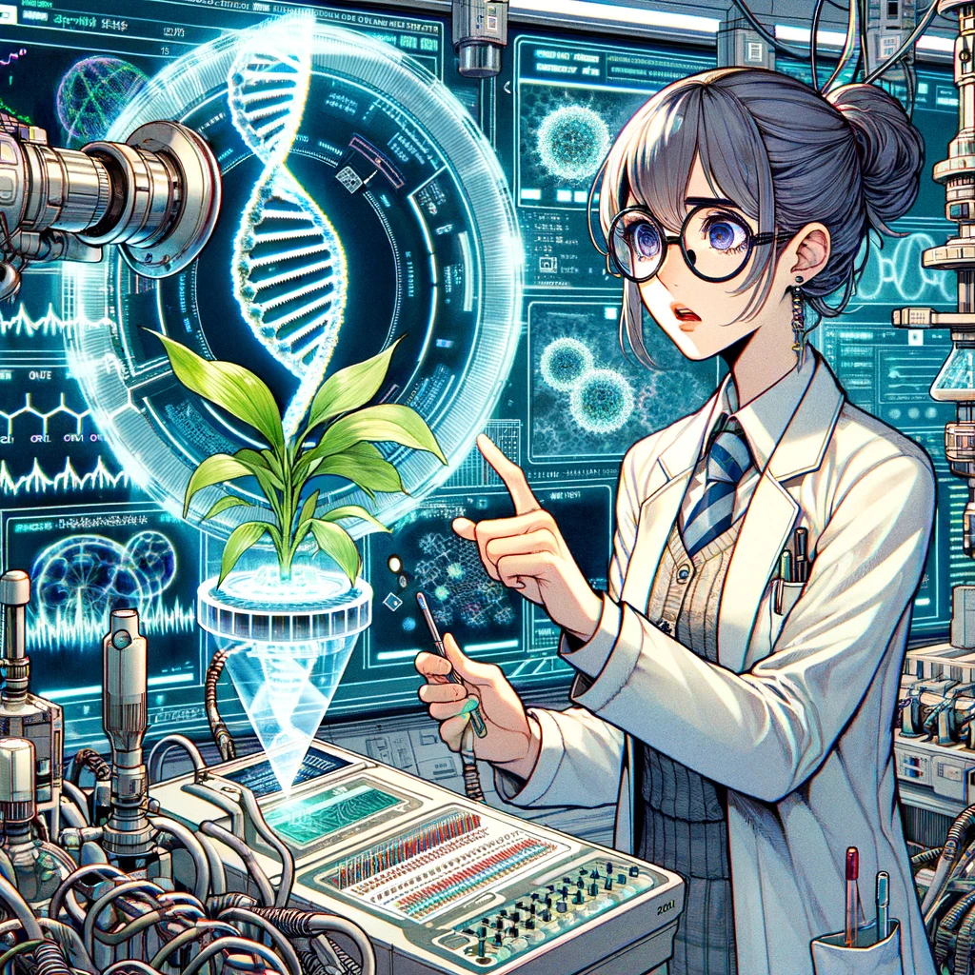
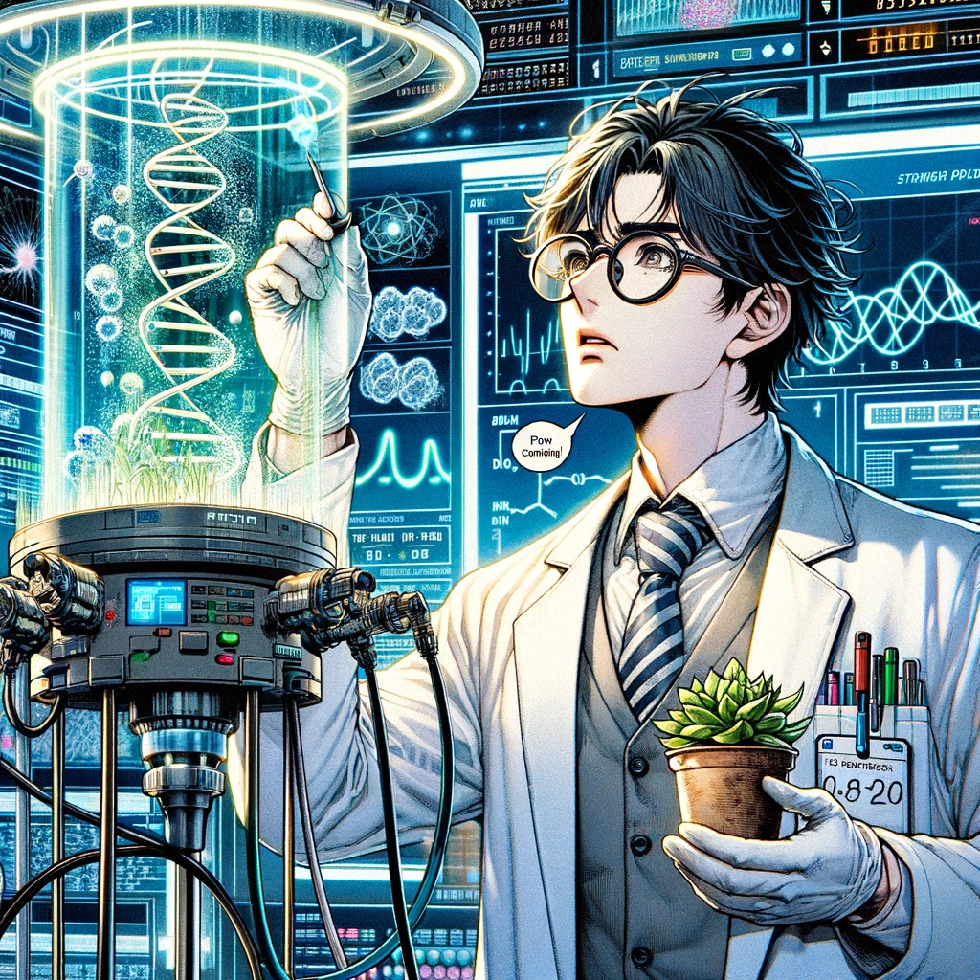
"Fascinating! Your heat stress proteins are off the charts!""
Astrobotany contains many mysteries
Notes:
Panel 3: Molecular Phenotyping
Description: A scientist in a lab coat is examining a readout from a machine that is analyzing a plant sample. The readout shows complex molecular data with graphs and numbers.
Dialogue: Scientist: "Fascinating! Your stress proteins are off the charts!"

Slide 4
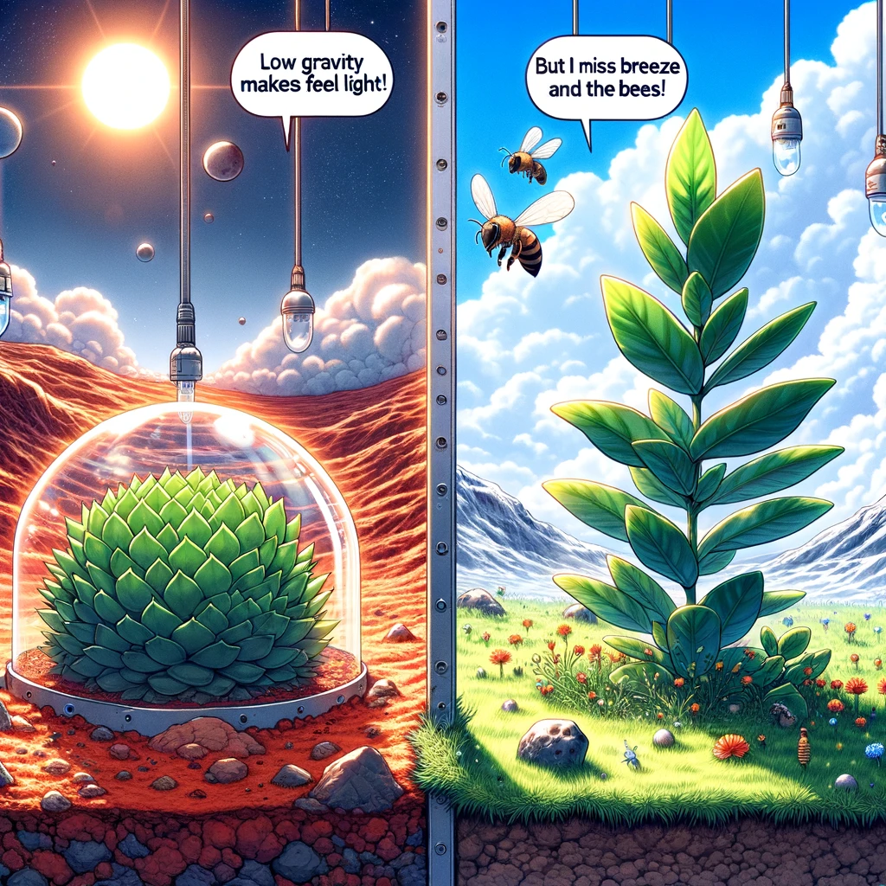
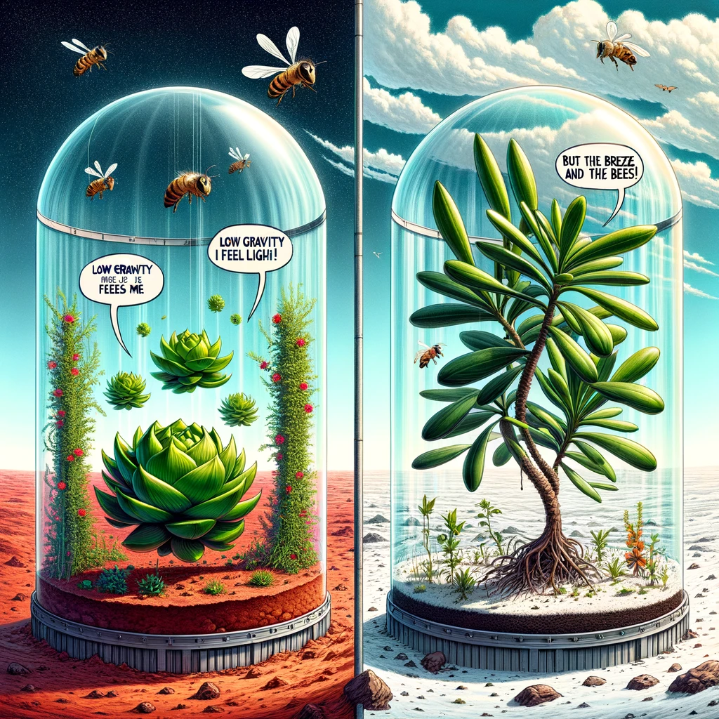
Botanists Study Plant Development under Different Conditions
Notes:
Description: Two plants side by side, one in a habitat simulating Mars and the other Earth. The Mars plant is shorter with thicker leaves, while the Earth plant is taller and more spread out. Dialogue: Mars Plant: "Low gravity makes me feel light!" Earth Plant: "But I miss the breeze and the bees!"”

Slide 5
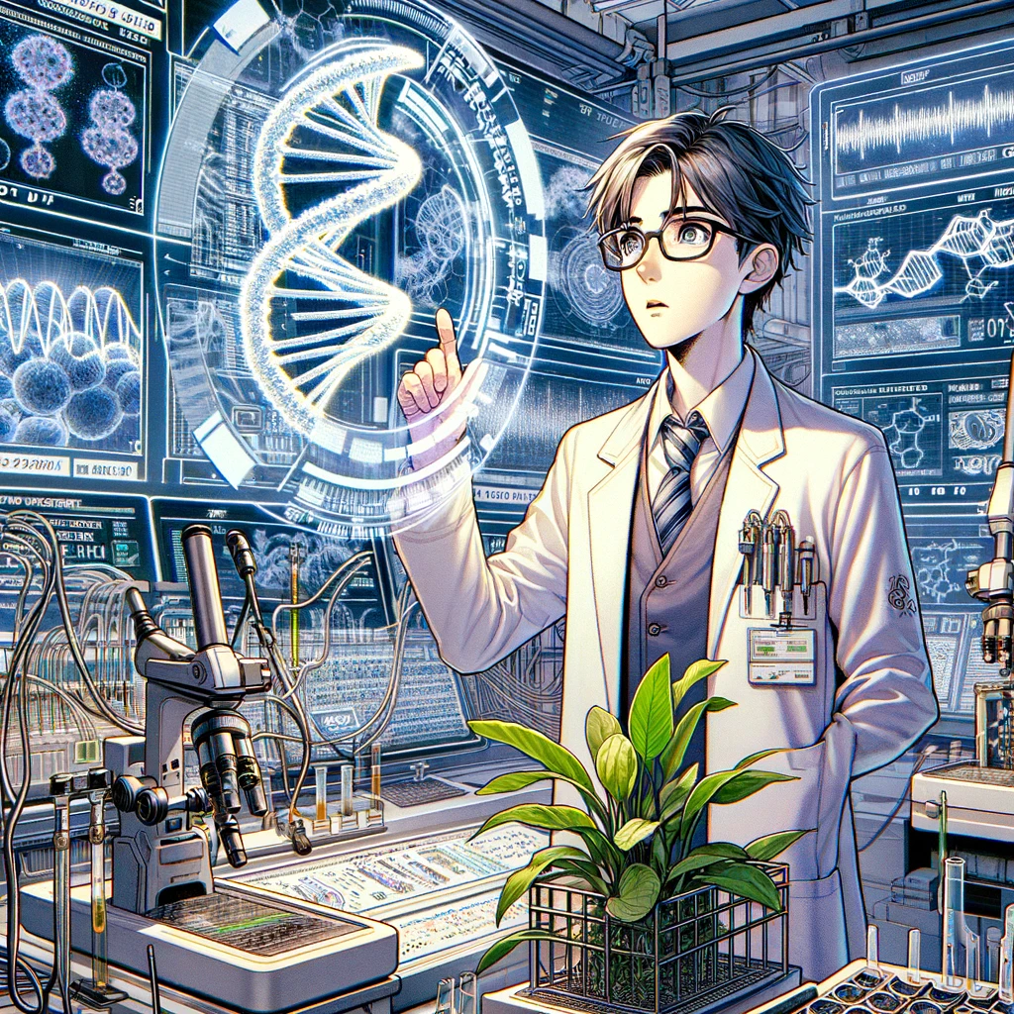
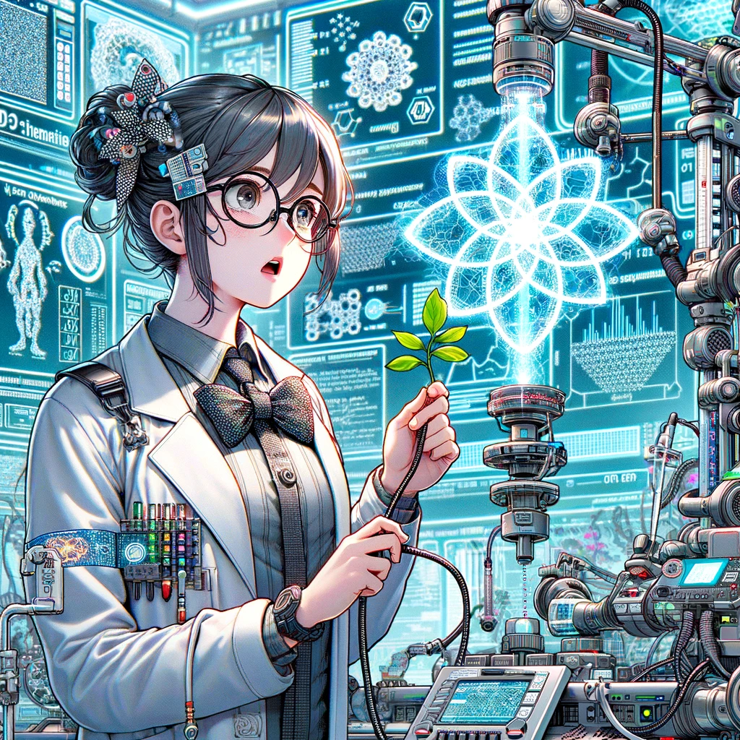
The complex molecular data is also being read by Artificial Intelligence (AI).
“We found clues hidden in the DNA”
Notes:
Panel 3: Molecular Engineering
Description: A scientist in a lab coat is examining a plant sample that was designed by a computer. The new molecular upgrades make the plants more productive then previously known and resistance to spaceflight.
Dialogue: Scientist: "Fascinating! Your stress proteins are off the charts!"

Slide 6
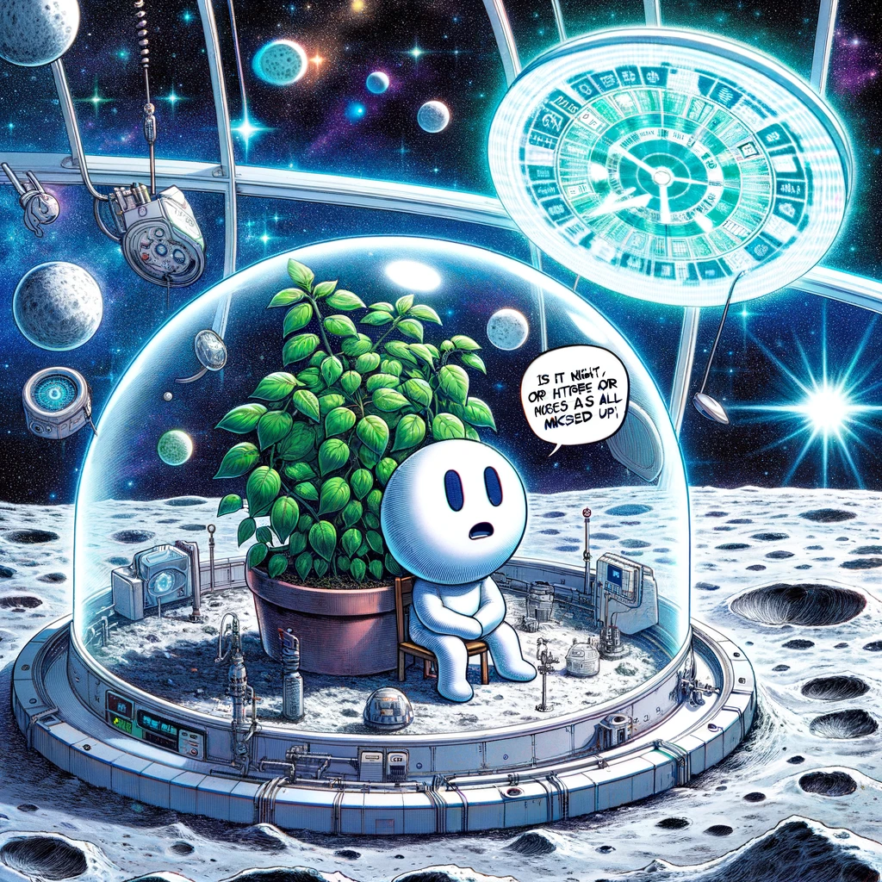
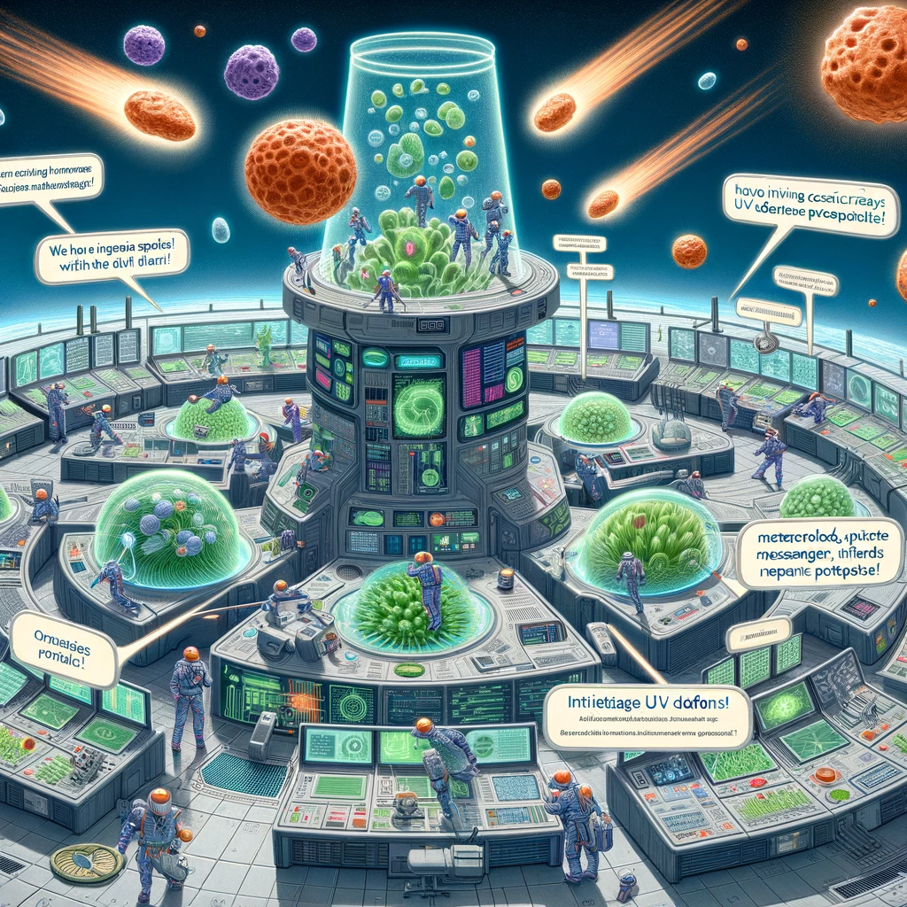
Effecting the plants immune system
Lunar regolith doesn’t contain any microbes
Notes:
Panel 4: Circadian Rhythms in Plants
Description: A plant with a confused expression sits with a clock, showing erratic time patterns. In the background, a window shows a starry space sky with multiple planet outlines, indicating an irregular day-night cycle.
Dialogue: Plant: "Is it night or day? My internal clock is all mixed up!"

Slide 7
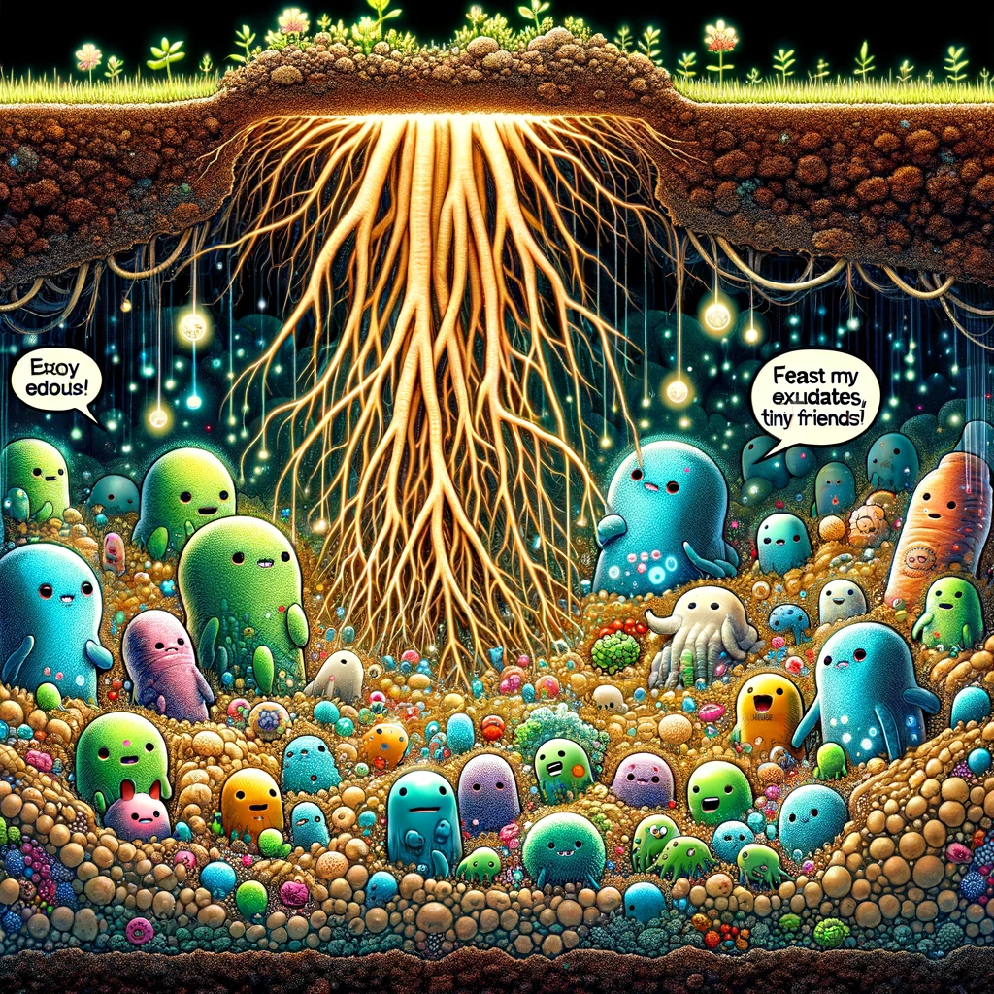
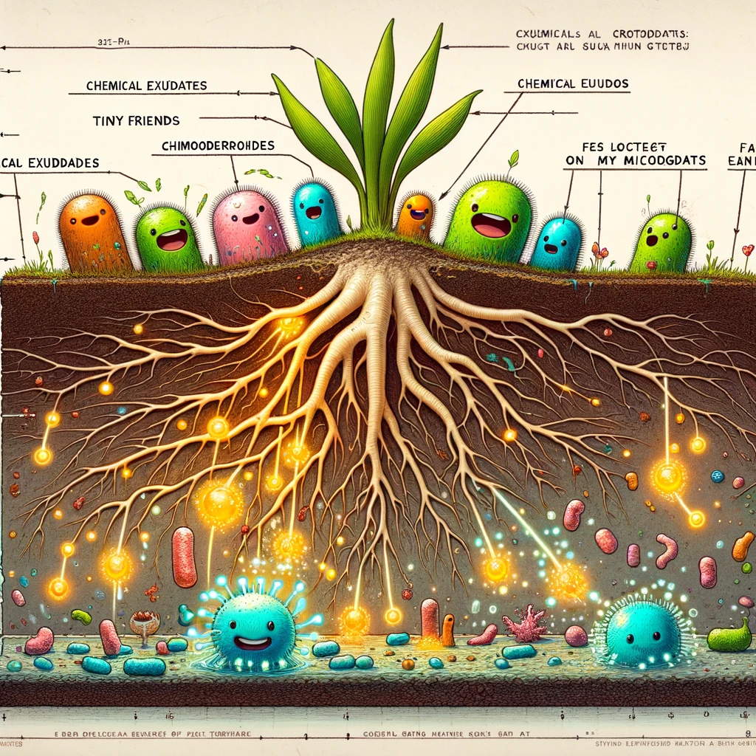
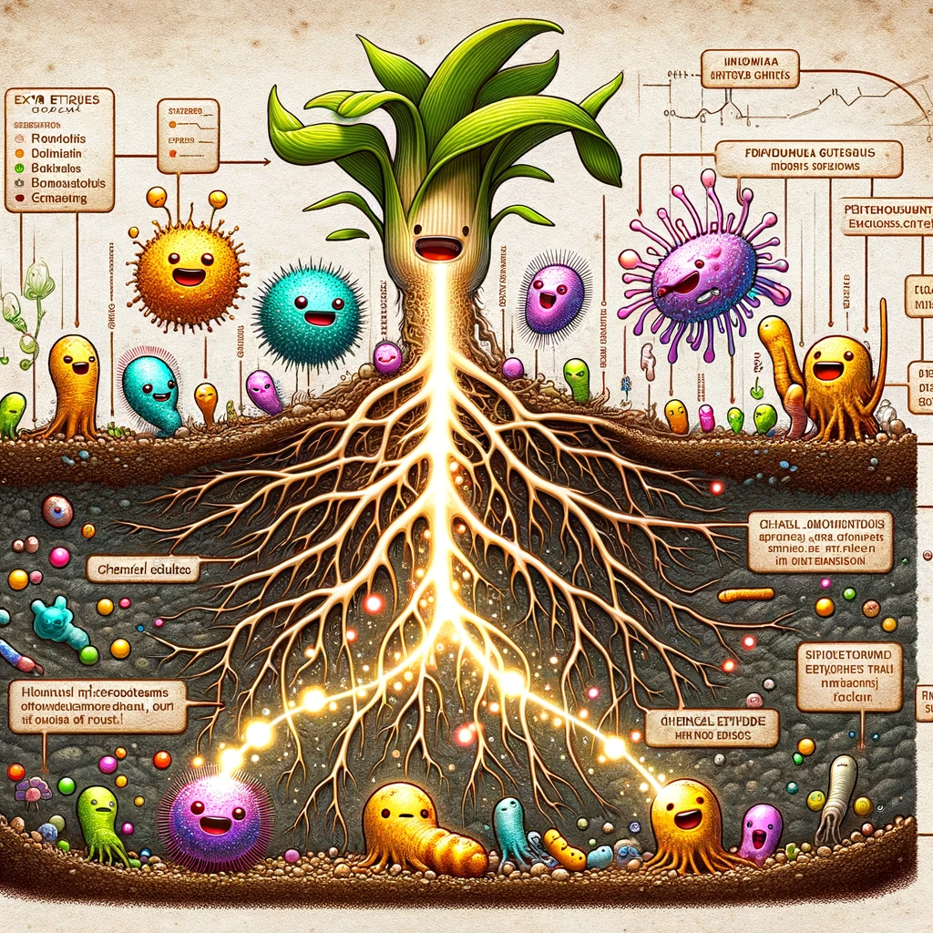
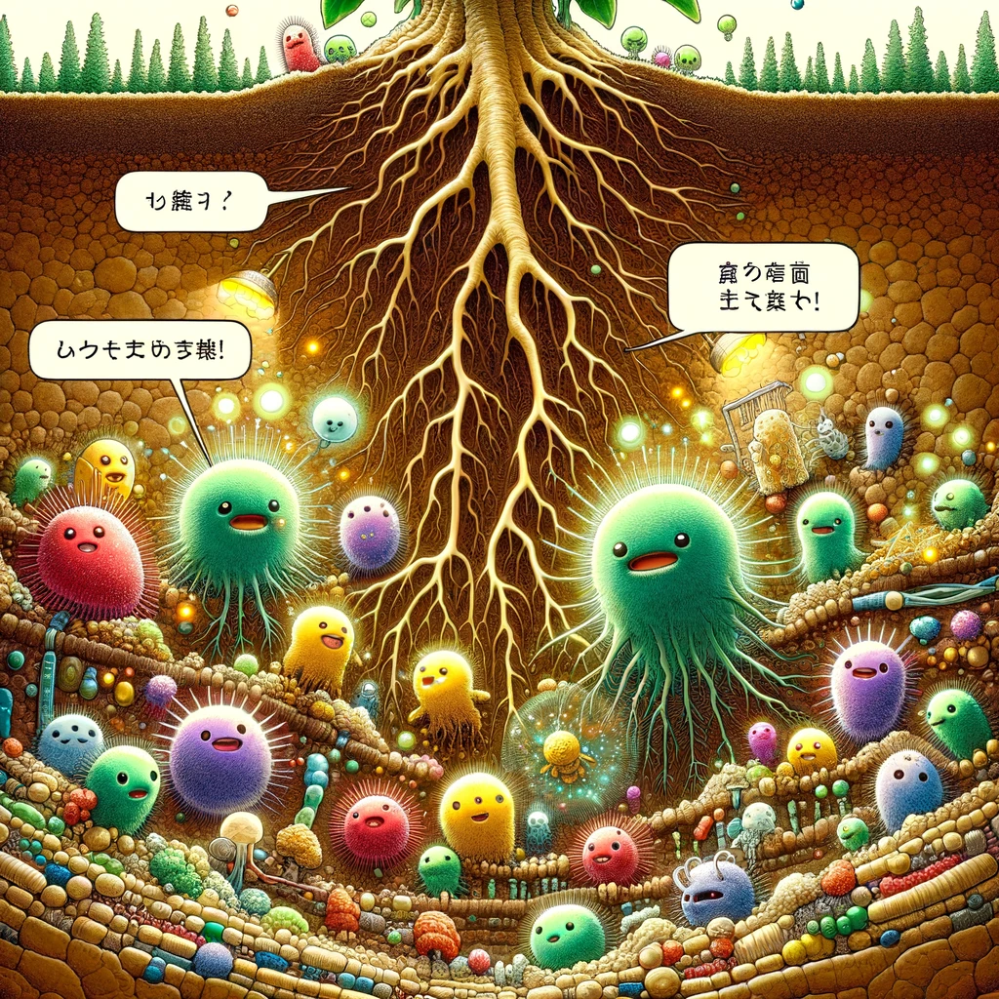
”Don’t forget the Hidden Half of Plant Biology!"
"Feast on my exudates, tiny friends!"
Notes:
Panel 5: Root Exudate and Microbiome Interactions
Description: The roots of a plant extend into the soil filled with colorful, anthropomorphized microorganisms. The roots are releasing chemical exudates, and the microbes appear happy as they interact with them.
Dialogue: Root: "Feast on my exudates, tiny friends!"

Slide 8
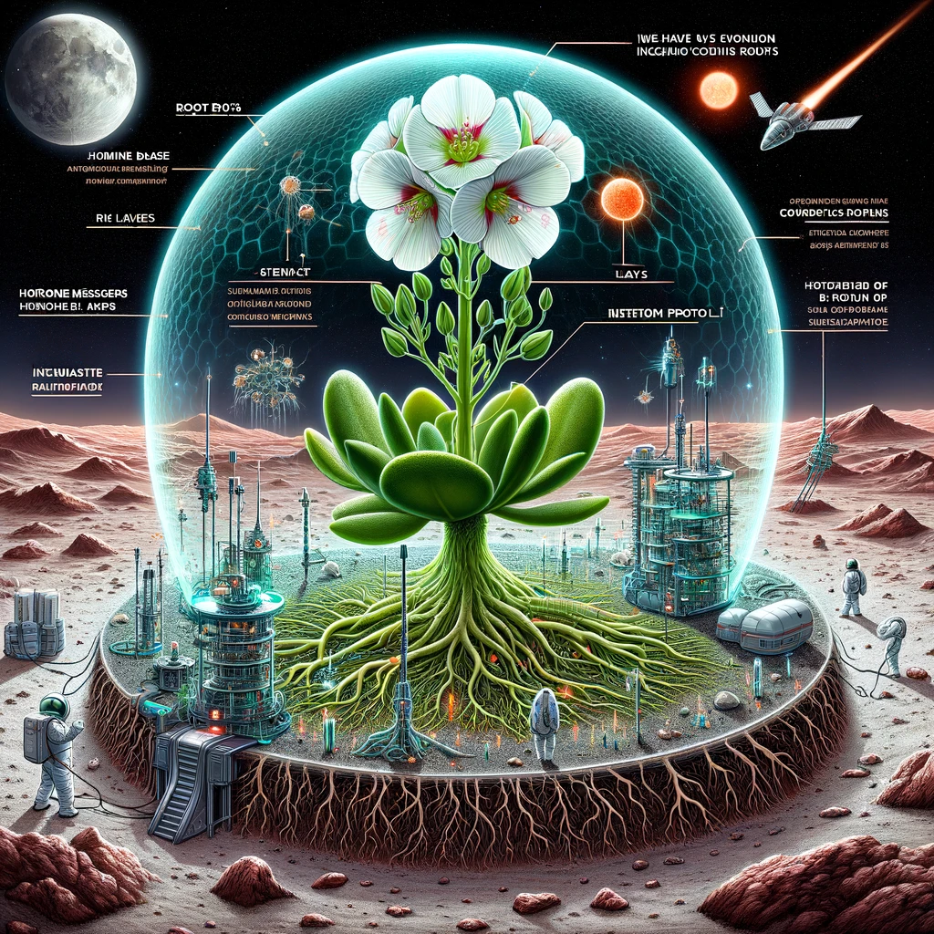
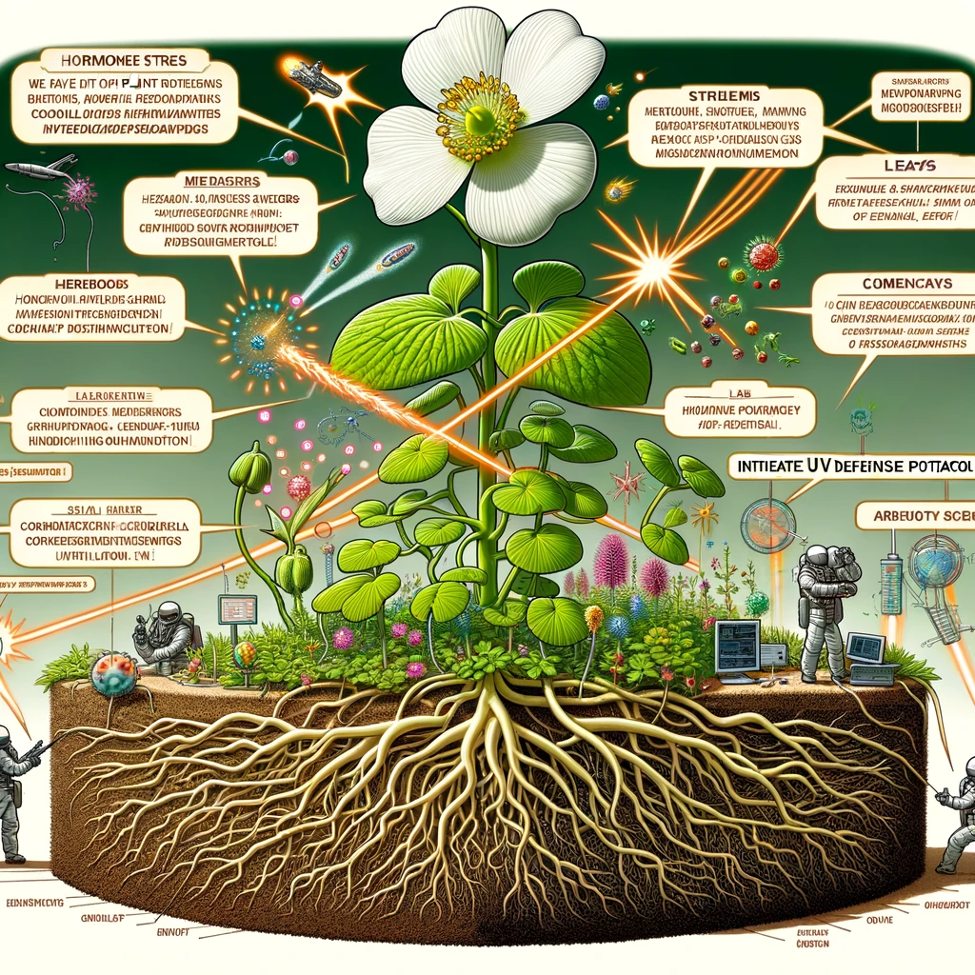
Plant defense system required for the moon
Support from microbes below the ground really help
Notes:
Panel 6: Plant Signaling and Adaptation
Description: Plant cells are depicted as a command center with plant hormones acting as messengers, rushing to different parts of the plant, which faces various space challenges like meteoroids and cosmic rays.
Dialogue: Hormone Messenger: "We have incoming cosmic rays! Initiate UV defense protocol!"

Slide 9
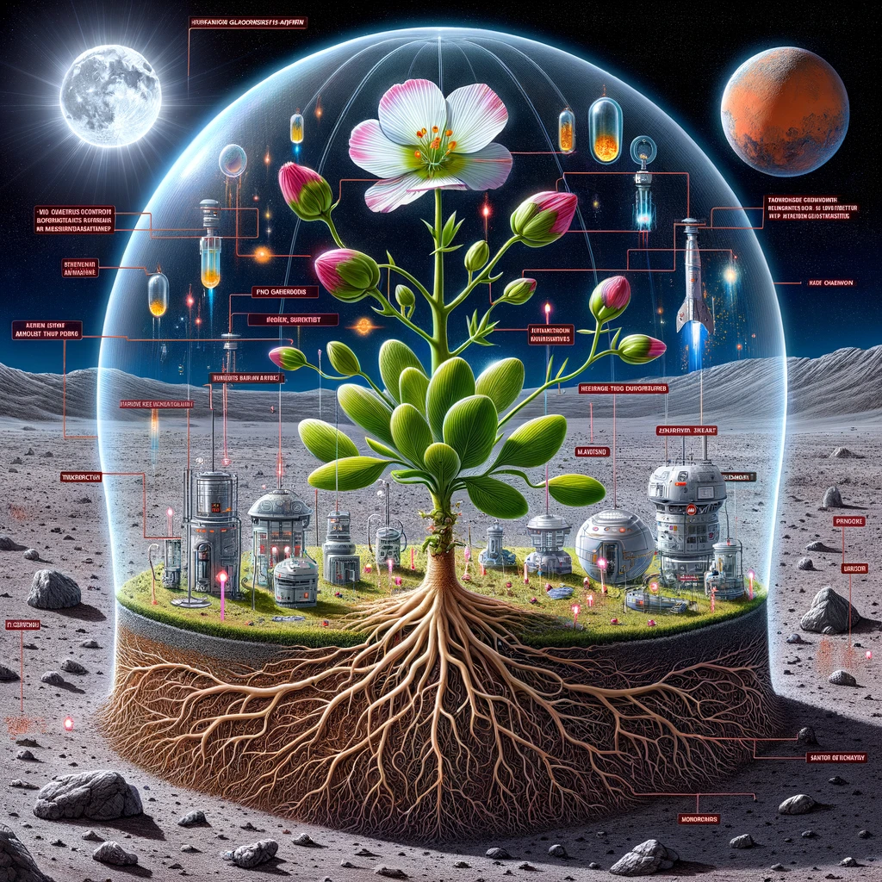
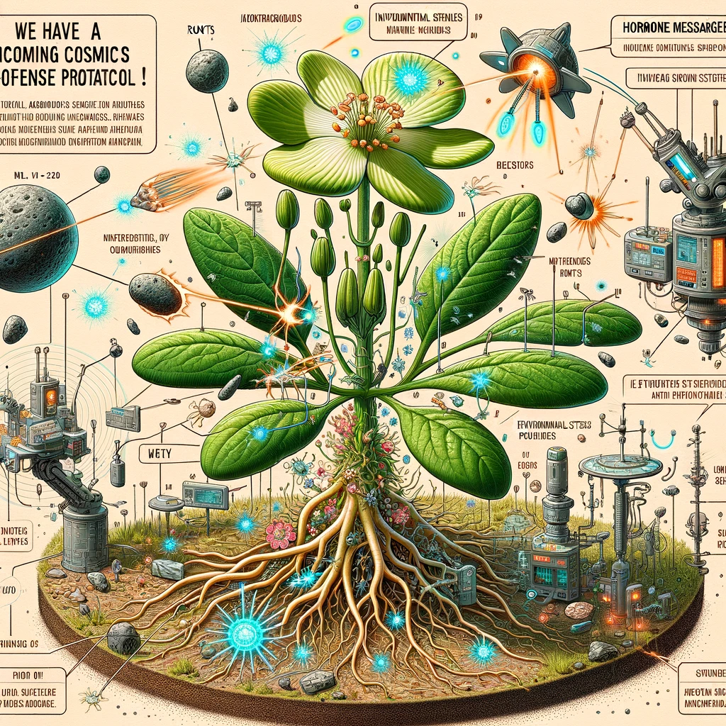
Different system required for asteroids and mars
Notes:
Panel 7: Natural variation and assisted environmental adaptation
Description: Plant cells are depicted as a command center with plant hormones acting as messengers, rushing to different parts of the plant, which faces various space challenges like meteoroids and cosmic rays.
Dialogue: Hormone Messenger: "We have incoming cosmic rays! Initiate UV defense protocol!"

